Slide 1
DS PROJECT: Online Library Management System
Group Members:
Aqib Mahmood 25235
Burhanuddin Makra 24460
Syed Muhammad Zuhair Shah 25130

Slide 2
Motivation
Booking to borrow books before hand.
Handling the borrowing and new arrival of books done by the admin.
Recommendation from the customer done online so that it is placed right before him.
Also, to distinct the customers if he is a member or not.

Slide 3
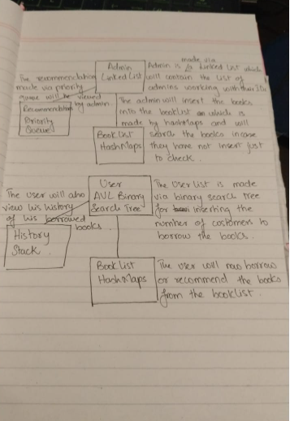
Method

Slide 4
Reasoning
Since History like stack is based on LIFO, the latest history updates.
Priority Queues for recommendation, for the books recommended by customers and recommended books come first based on the customer being a member or a non-member.
Hashing using Quadratic probing so that we can store a large set of data i.e the set of books and access the books without any storage wastage and time efficient searching, insertion and deletion of books.
Linked List is used for the memory allocation and faster insertion and deletion of admin data as there are limited number of admins.
AVL trees are also used for efficient search for the login and data extraction of a user as they are balanced trees hence the searching is O(logn).

Slide 5
Data:
Example Data of books along with author:
1. Collected Longer Poems of Kenneth Rexroth Rexroth Kenneth
2. Great Clod: Notes And Memoirs On Nature And History In East Asia Snyder Gary
3. Beat Down To Your Soul Author; Charters Ann ed.
4. Man Rays Montparnasse Lottman Herbert R.
5. Jay DeFeo And The Rose Green Jane
Example Data of User:
“aqib", "aqib123", true, 123
2. “burhan", "burhan234", false, 234
"zuhair", "zuhair345", false, 345
Example Data of Admin:
01, "ali", "ali01"
02, "ahmed", "ahmed02"

Slide 6
Complexity Analysis (Big O)
Function | Insert | Search | Delete
LinkedList (For Admins) | O(N) | O(N) | -
Hash Map (For Books) | O(N) | O(N) | O(N)
Stack (For storing history) | O(1) | - | O(1)
Priority Queue (For storing recommendation using user’s member status) | O(N) | - | O(1)
AVL Tree (For searching user’s ID and Password) | O(Log(N)) | O(Log(N)) | -

Slide 7
Resource Citation
GeeksforGeeks for finding the syntax to extract the alphanumeric values from the text field from the GUI screen.

Slide 8
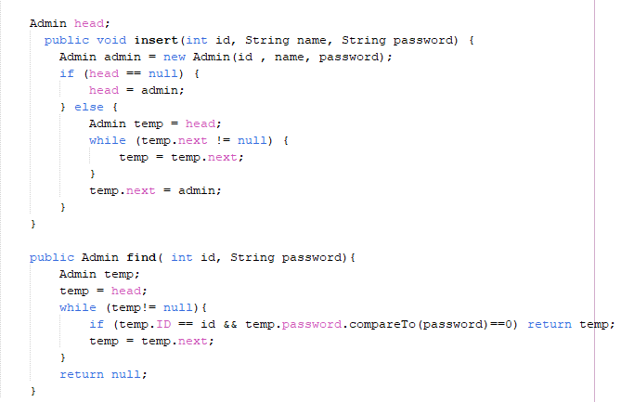
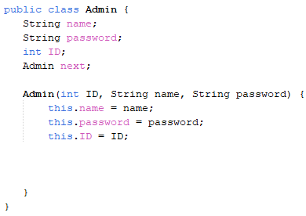
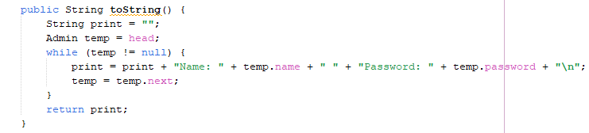
Admin List

Slide 9
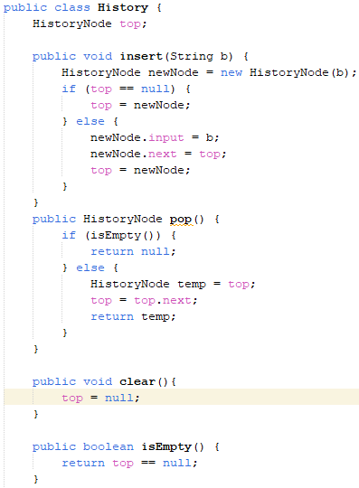
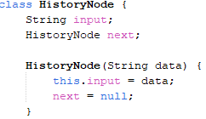
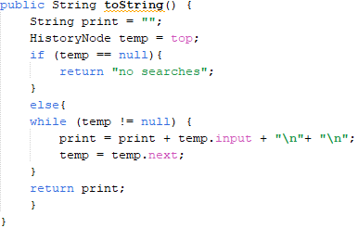
History

Slide 10
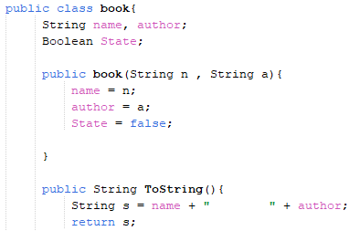
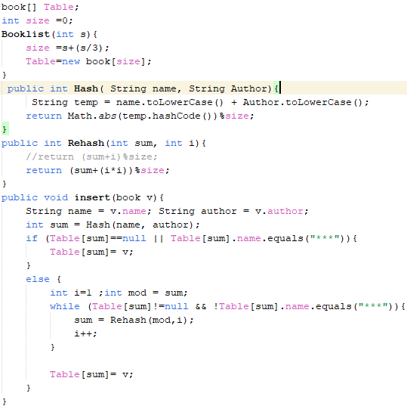
Booklist

Slide 11
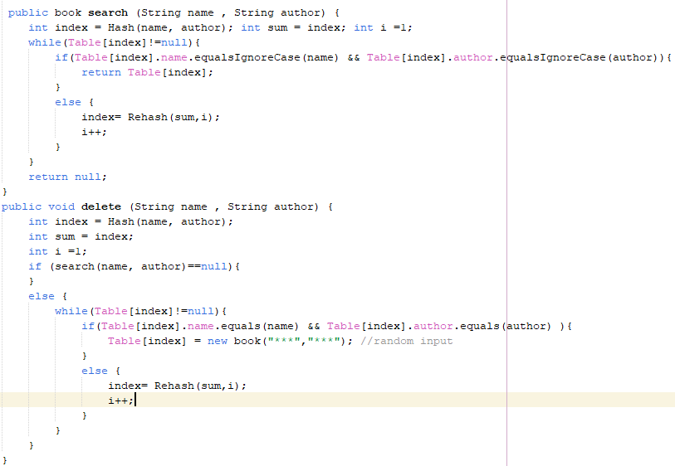
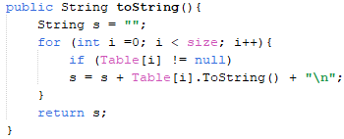

Slide 12
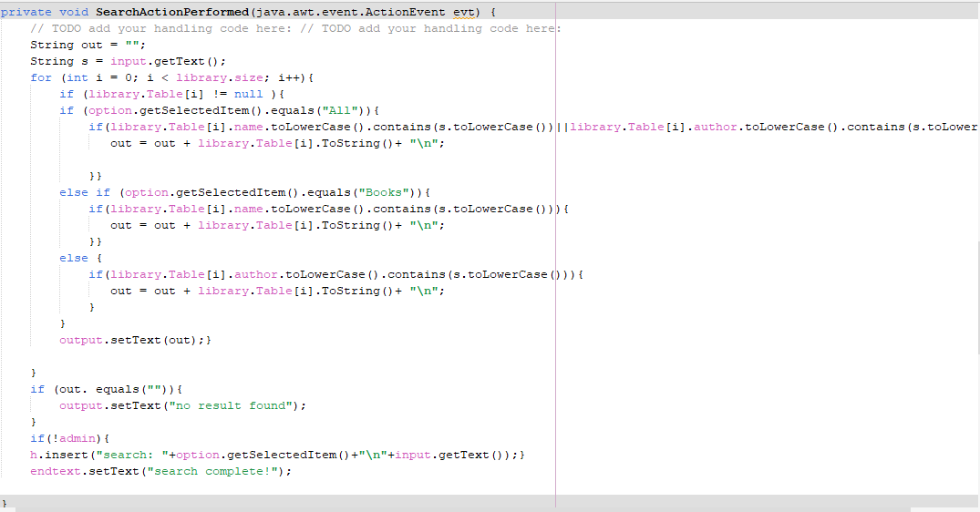
Library Screen Search

Slide 13
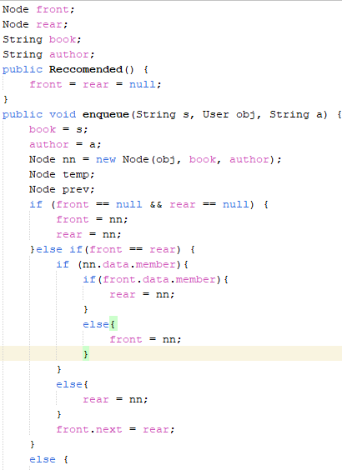
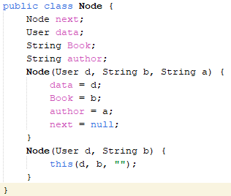
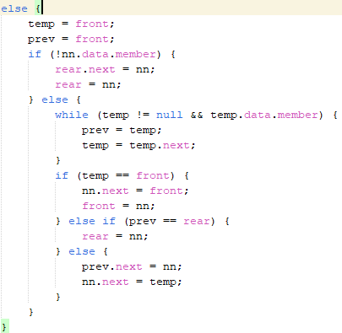
Recommended

Slide 14
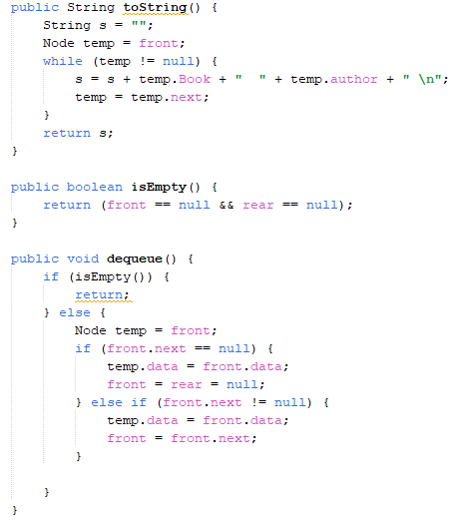

Slide 15
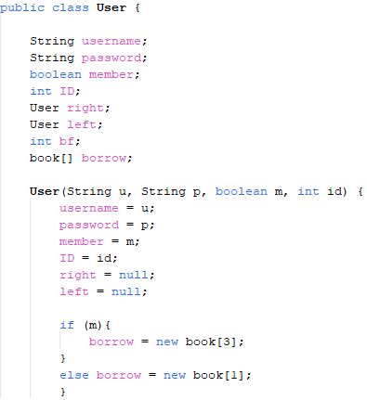
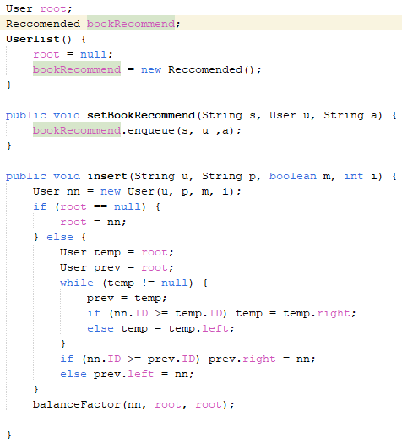
Userlist

Slide 16
